Slide 1

NSG Pilkington – University of Liverpool Machine Learning Project: 20/05/2021
Dr. Peter Green
Diego Echeverria
Sarini Jayasinghe
Risk Institute,
School of Engineering

Slide 2
Today
Recap: we currently have 2 sets of input data
Dataset 1 uses the old combination strategy (as led to the video shown in the gate meeting)
Dataset 2 uses the new combination strategy (but hadn’t led to an improvement in the linear model)
Today we’ll cover:
Dataset 2 Combination Signals
Neural Network
Dataset 1
Dataset 2
Conclusions
Clustering by Product Type
Density Based Clustering of Fault Data
Upskilling

Slide 3
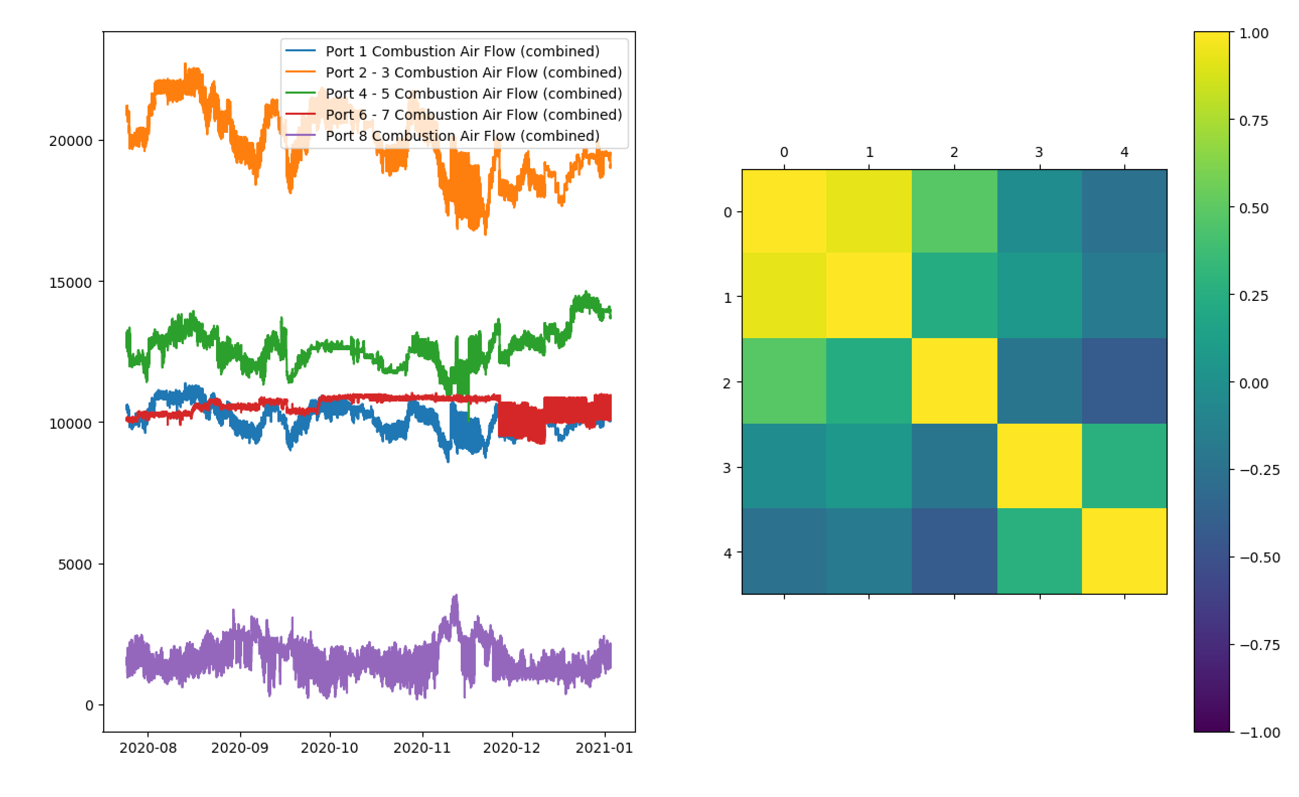
Dataset 2 – Combination Signals

Slide 4
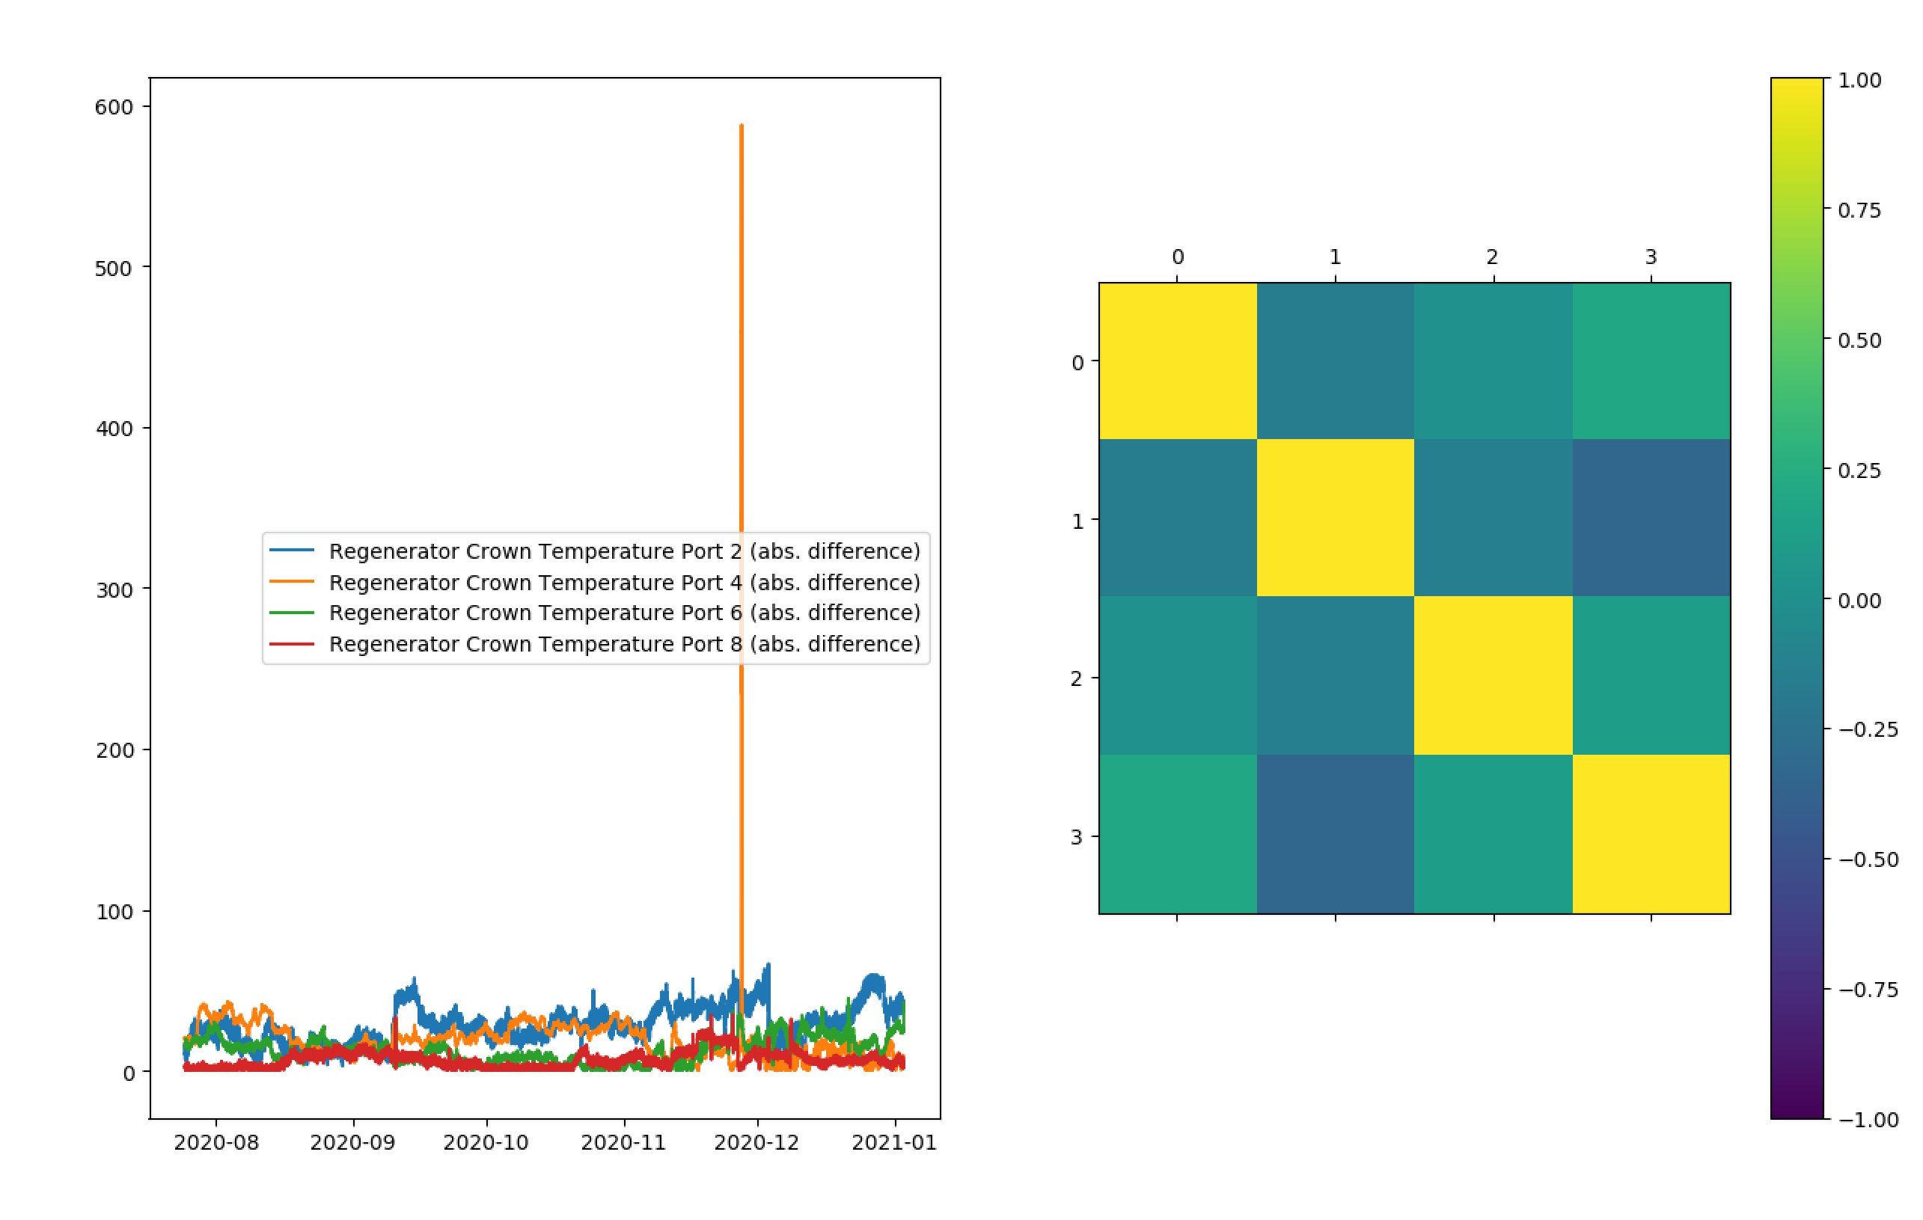
Dataset 2 – Combination Signals

Slide 5
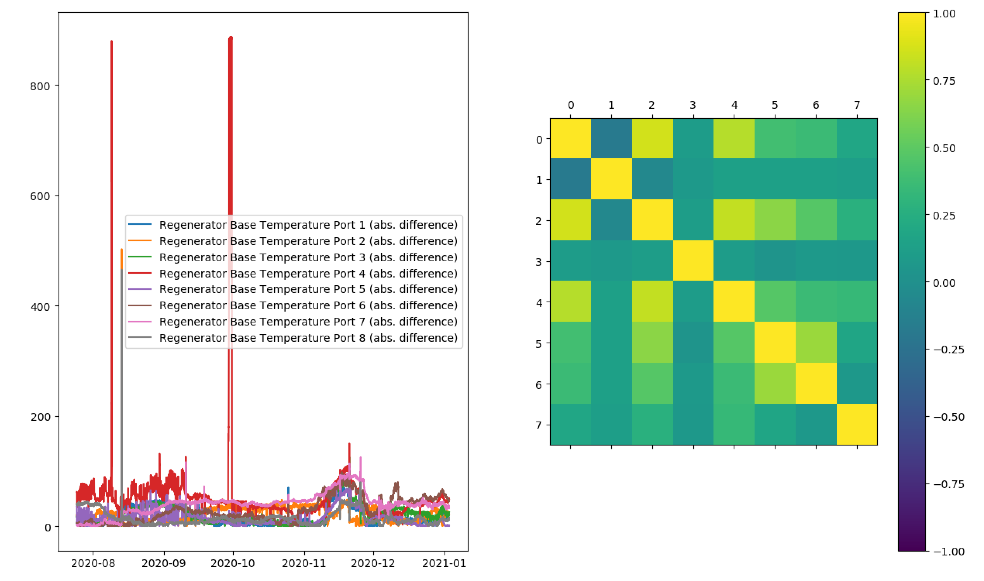
Dataset 2 – Combination Signals

Slide 6
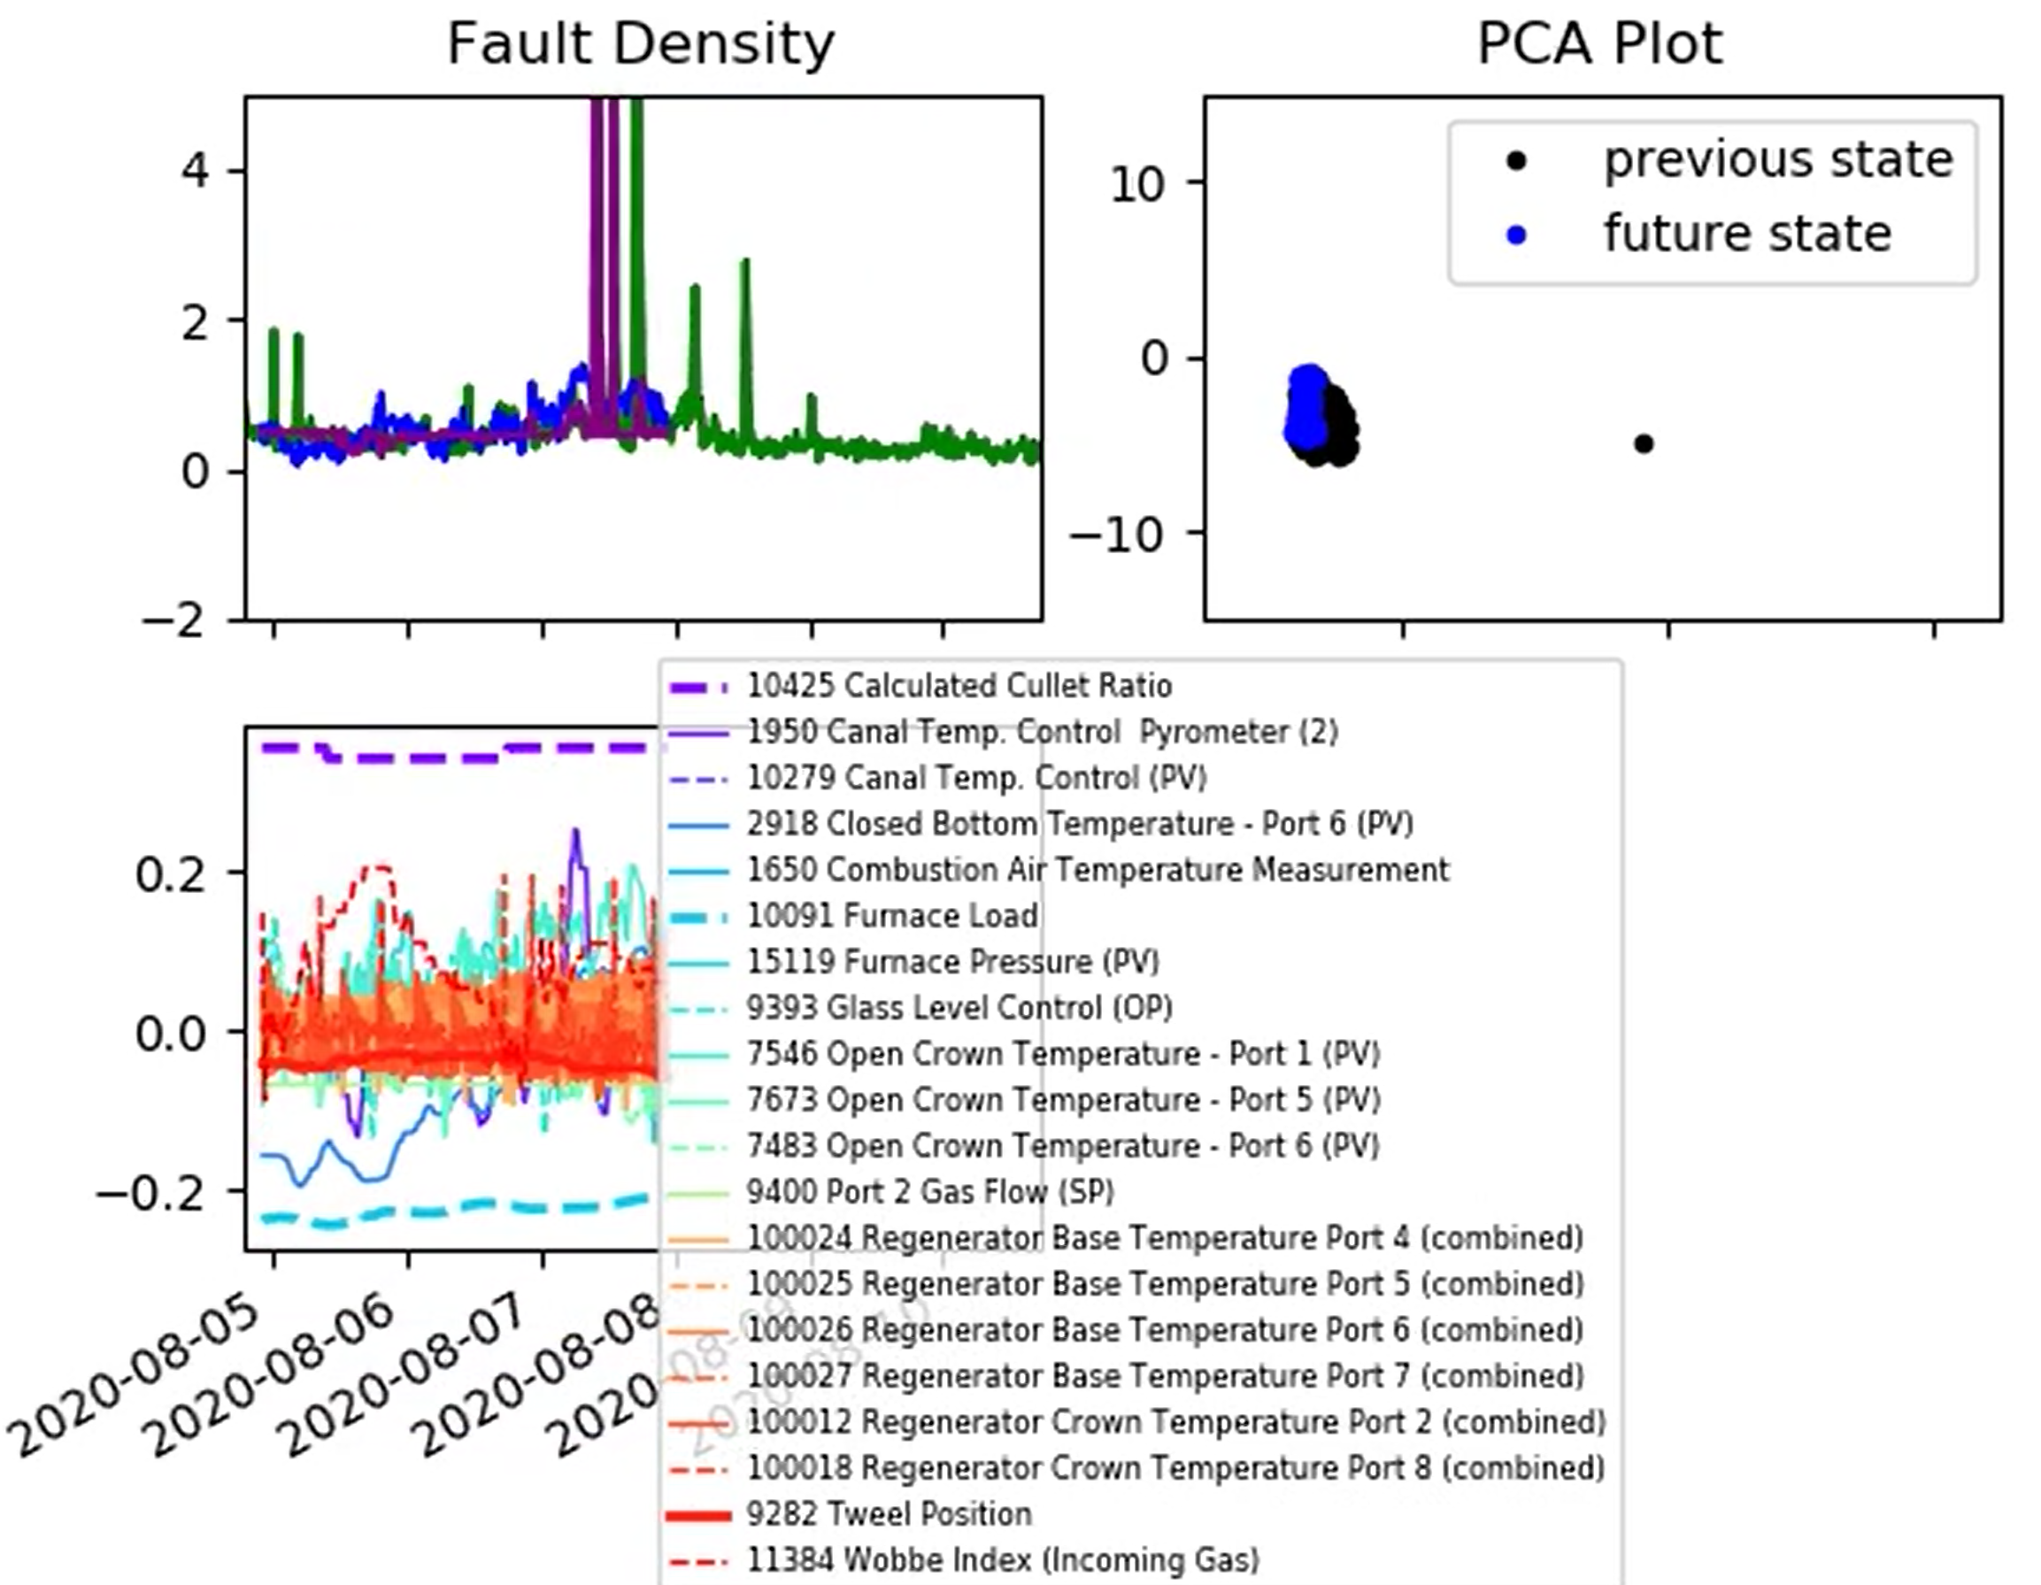
Neural Network – Dataset 1
In the following, the neural network predictions are in purple and are plotted next to the blue linear regression predictions. Note: for now, the neural network is not being updated online.
Being very flexible, neural networks are vulnerable to overfitting, particularly for our noisy fault density data.
This can lead to some strange-looking results when we move beyond the training data (as shown here).

Slide 7
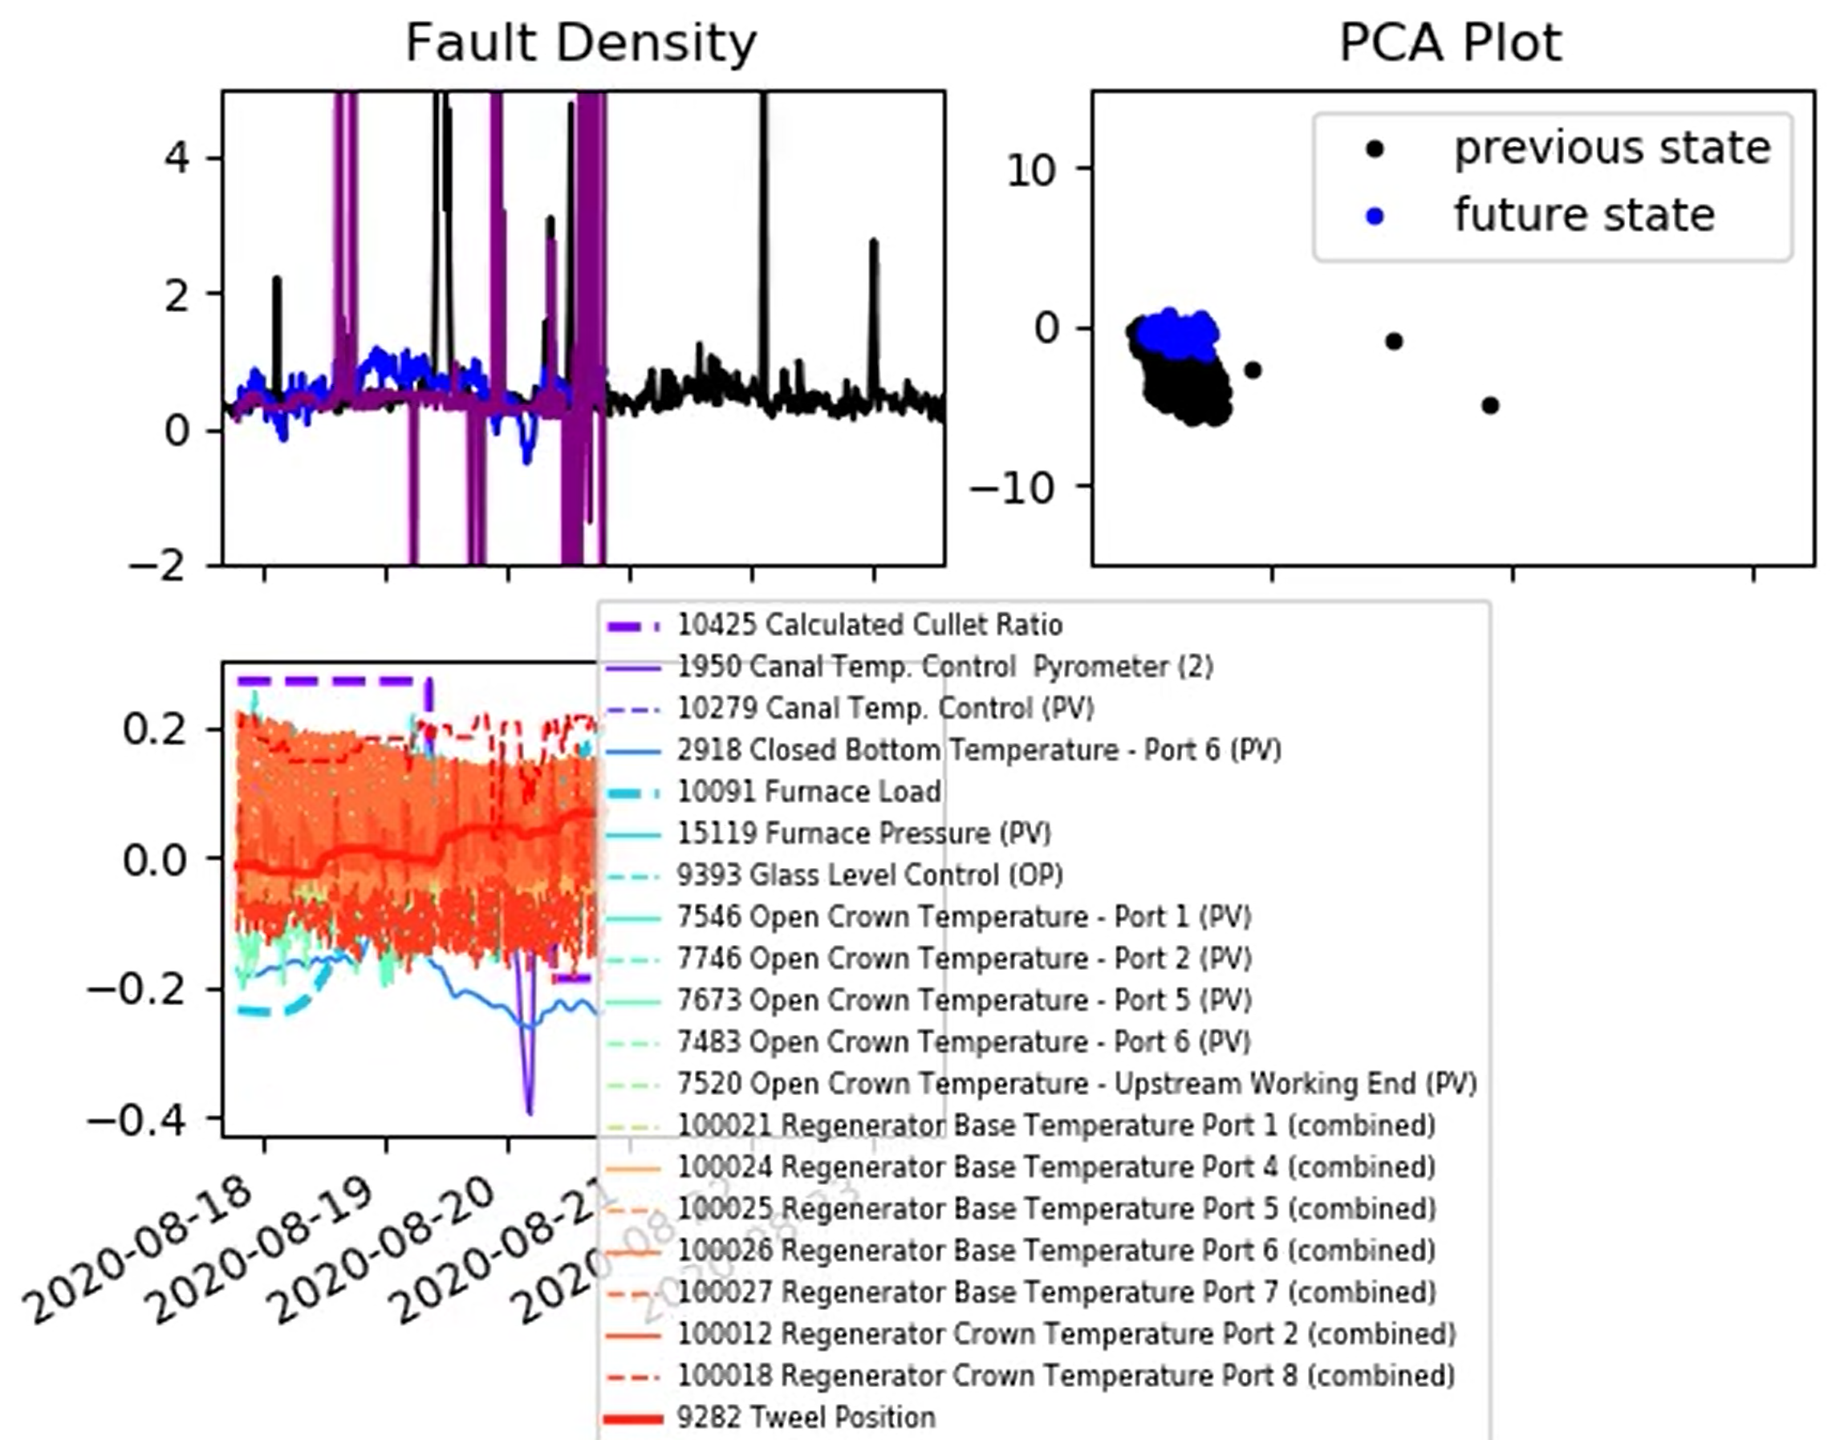
Neural Network – Dataset 1
In the following, the neural network predictions are in purple and are plotted next to the blue linear regression predictions. Note: for now, the neural network is not being updated online.
Being very flexible, neural networks are vulnerable to overfitting, particularly for our noisy fault density data.
This can lead to some strange-looking results when we move beyond the training data (as shown here).

Slide 8
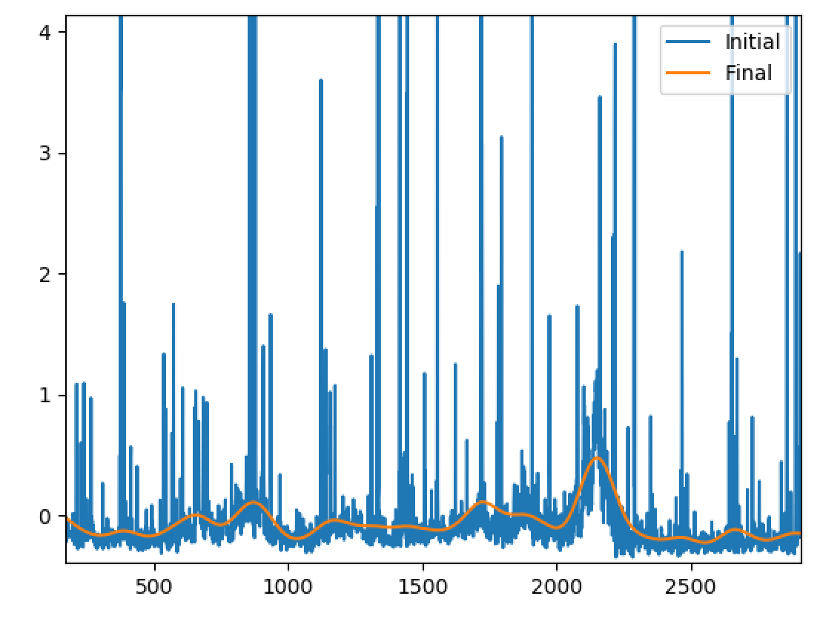
Neural Network – Dataset 1
This forces us to address the noise issues associated with the furnace fault data.
Here, we have pushed our spike removal and filtering blocks as far as we think we can get away with…

Slide 9
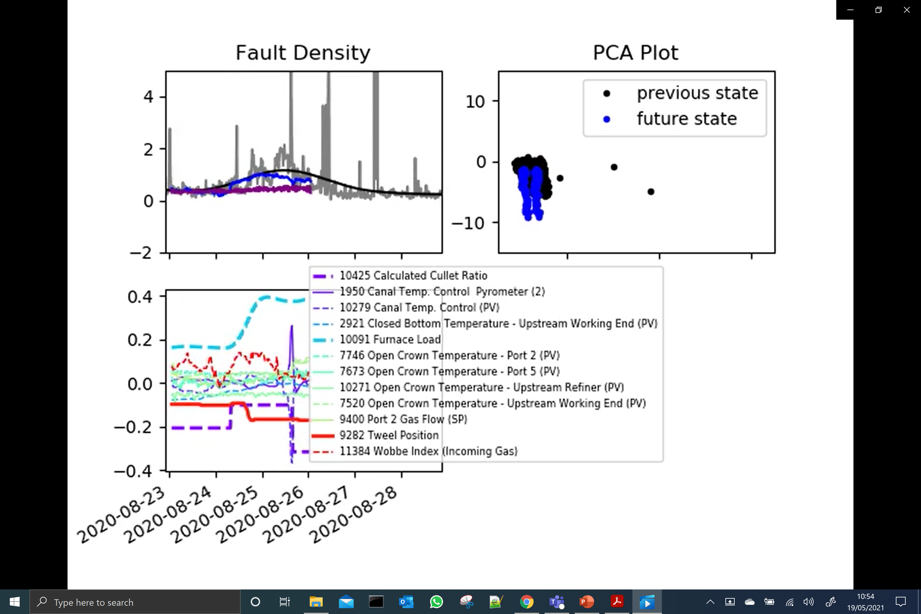
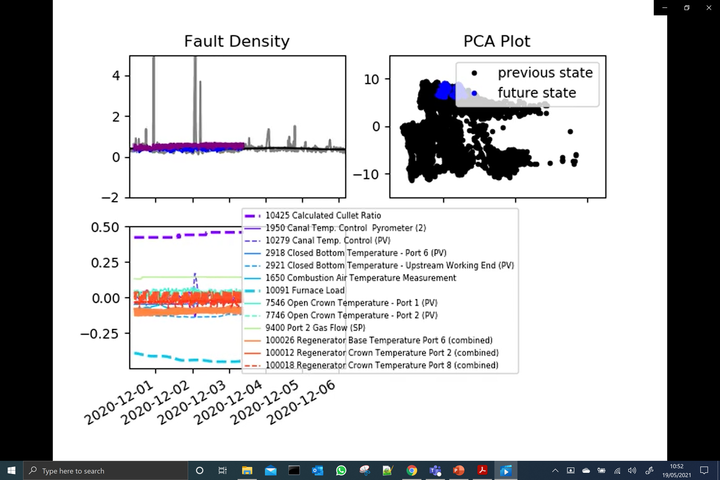
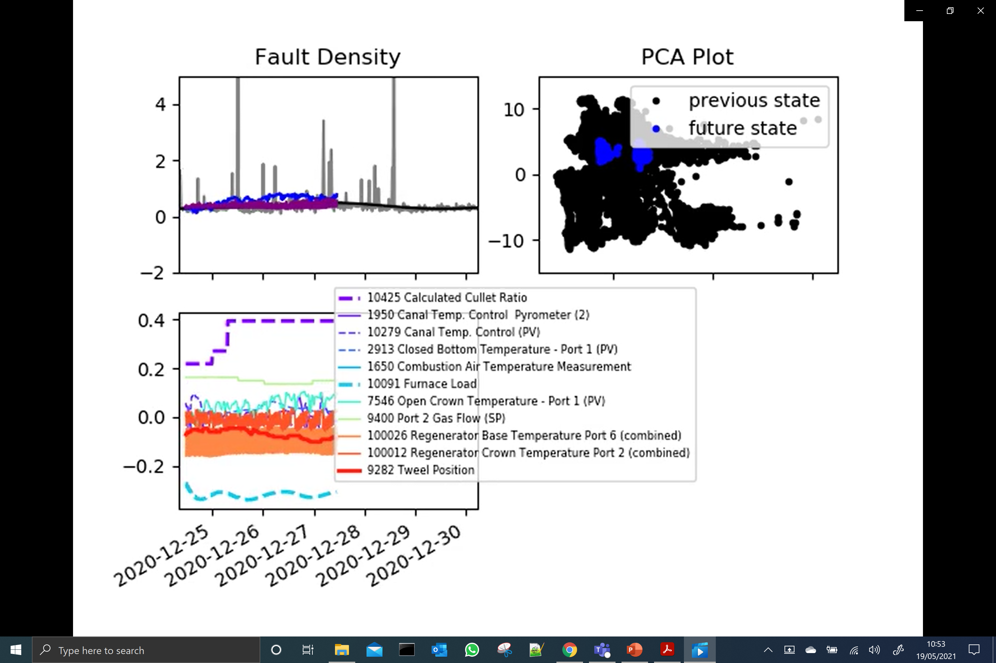
Neural Network – Dataset 1
Neural network predictions improve a lot.
Isn’t able to model the first rise in fault density.
Some regions are comparable to the linear regression approach.
Is also able to out perform linear regression in some cases.

Slide 10
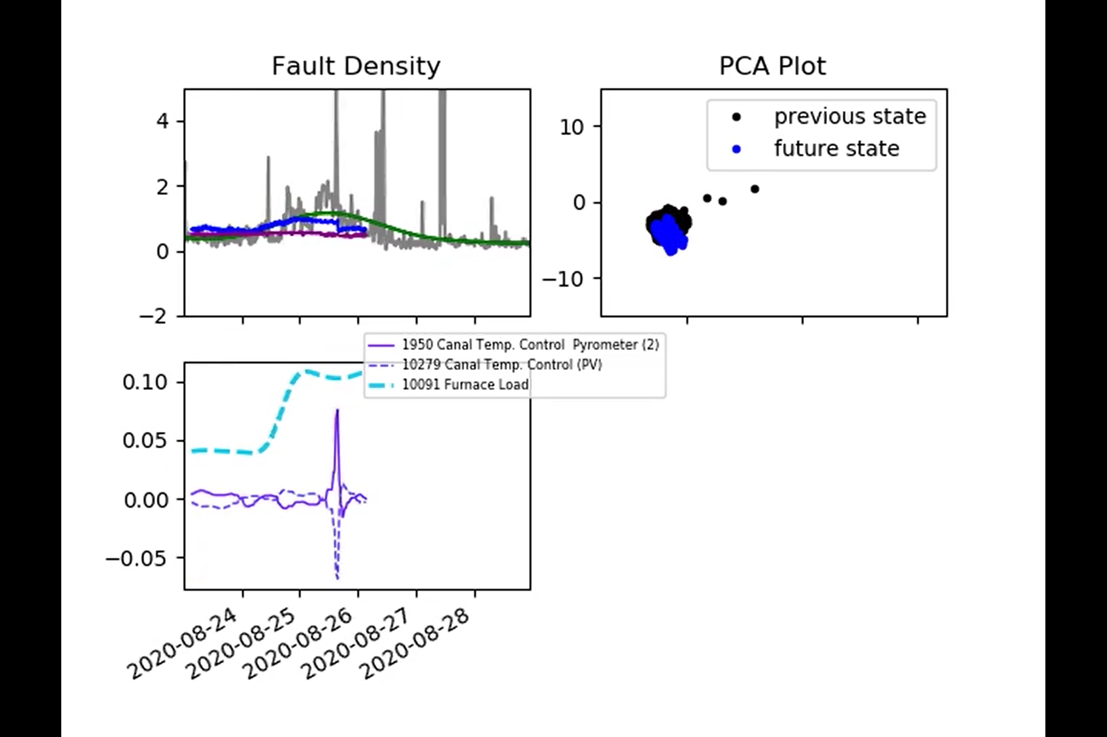
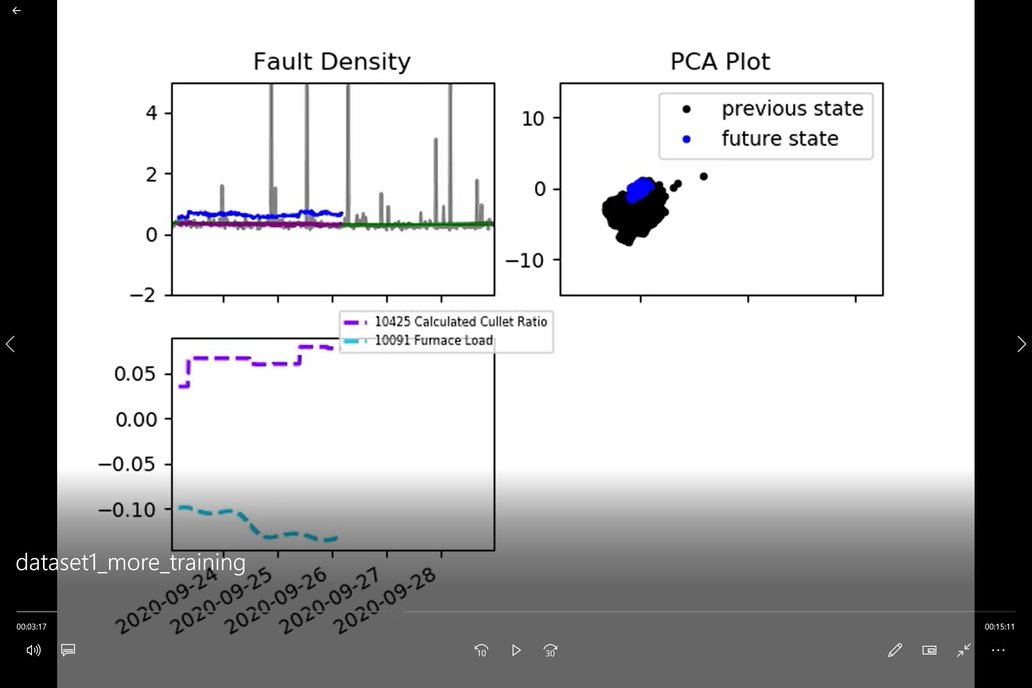
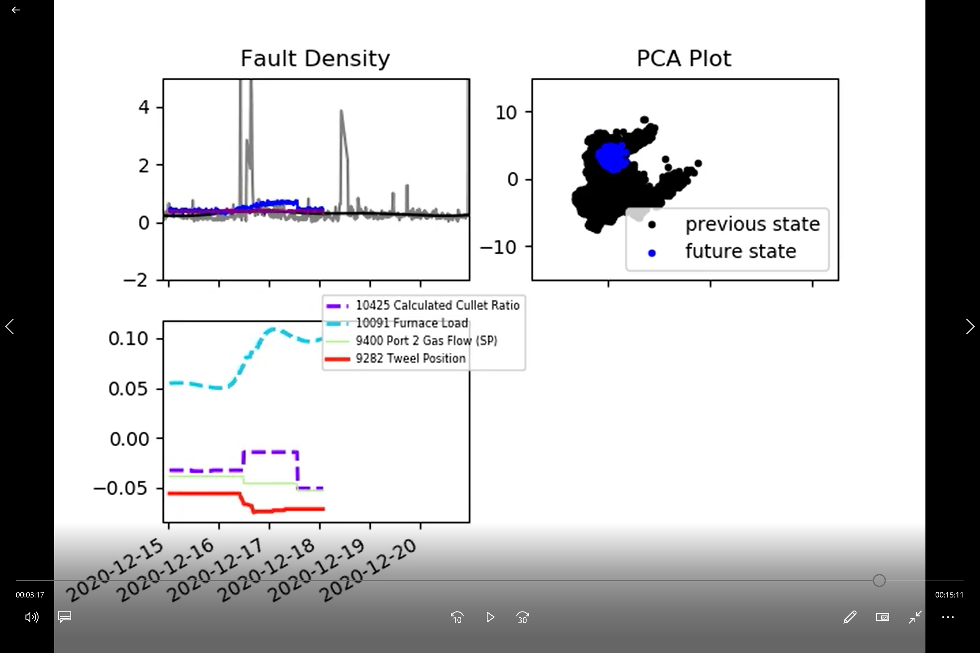
Neural Network – Dataset 1
Neural networks typically need a lot of training data. Here we’ve increased the number of training points from 1000 to 5000 (which now includes the first rise).
Interestingly, isn’t able to capture the first rise (even though it’s in the training data).
But good performance elsewhere.

Slide 11
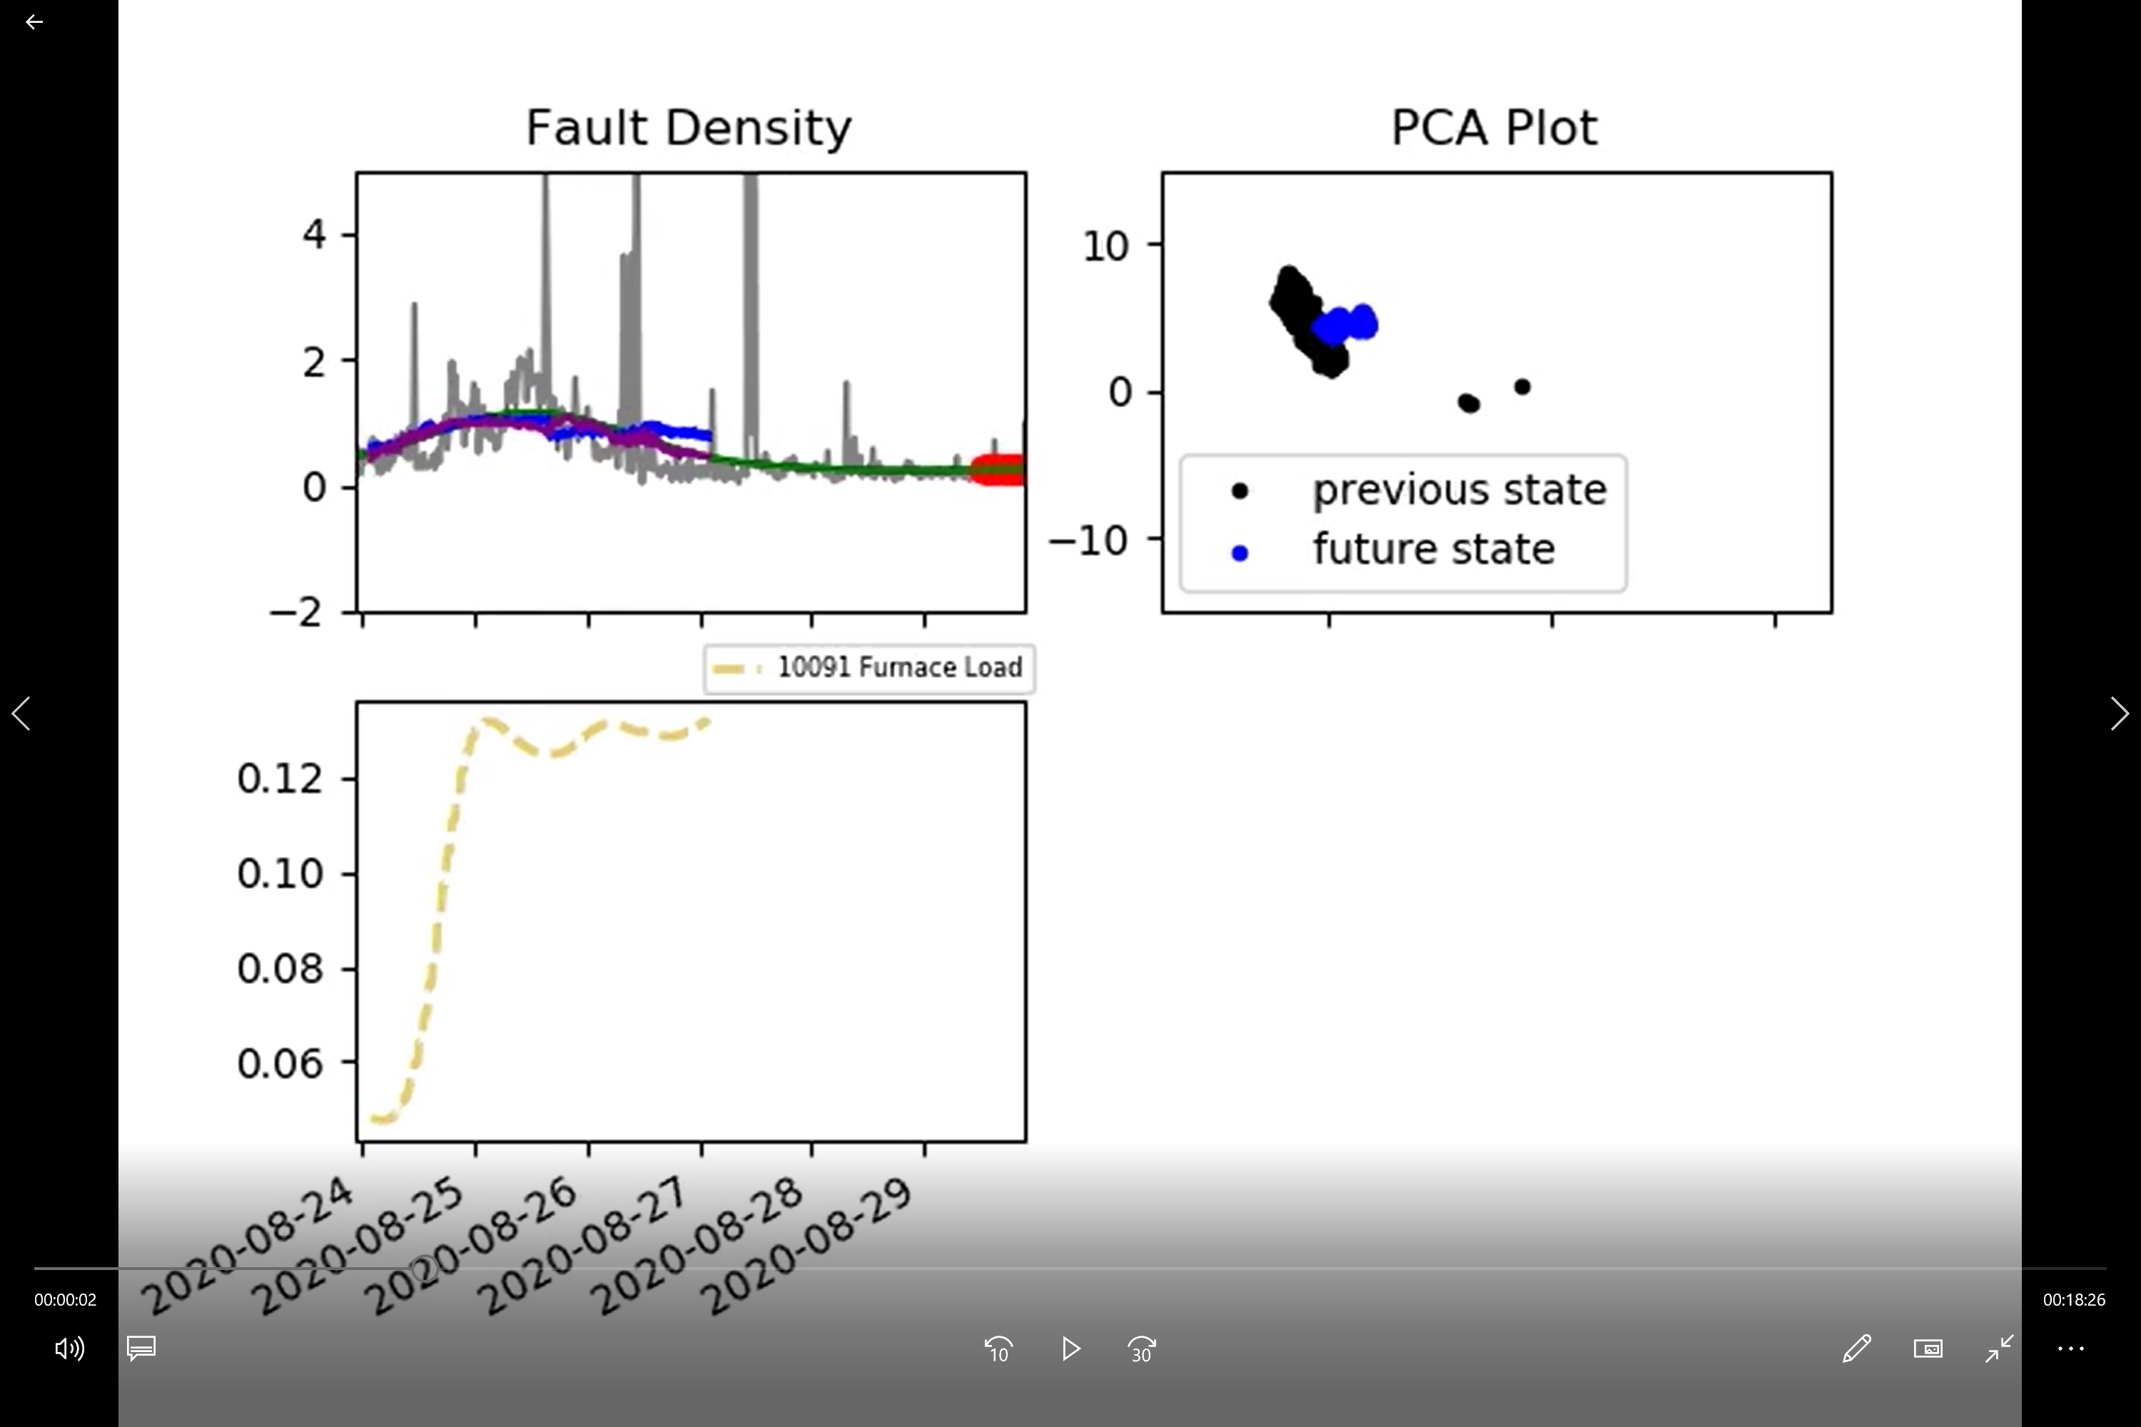
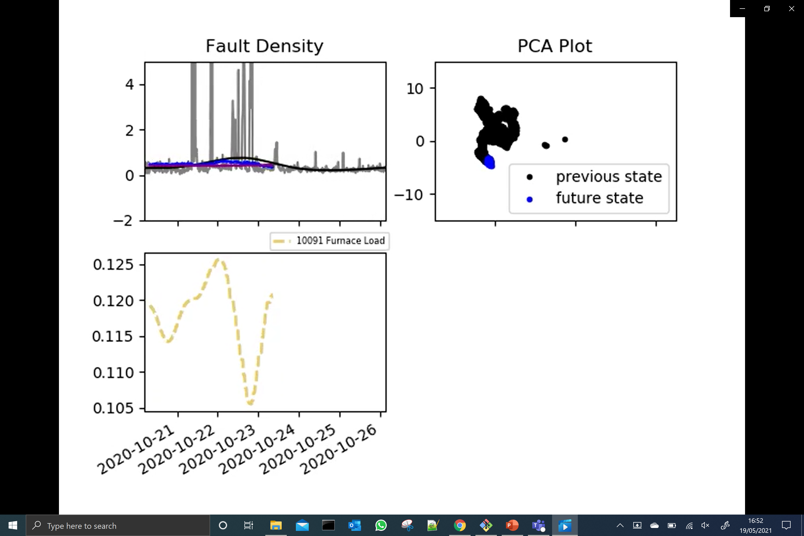
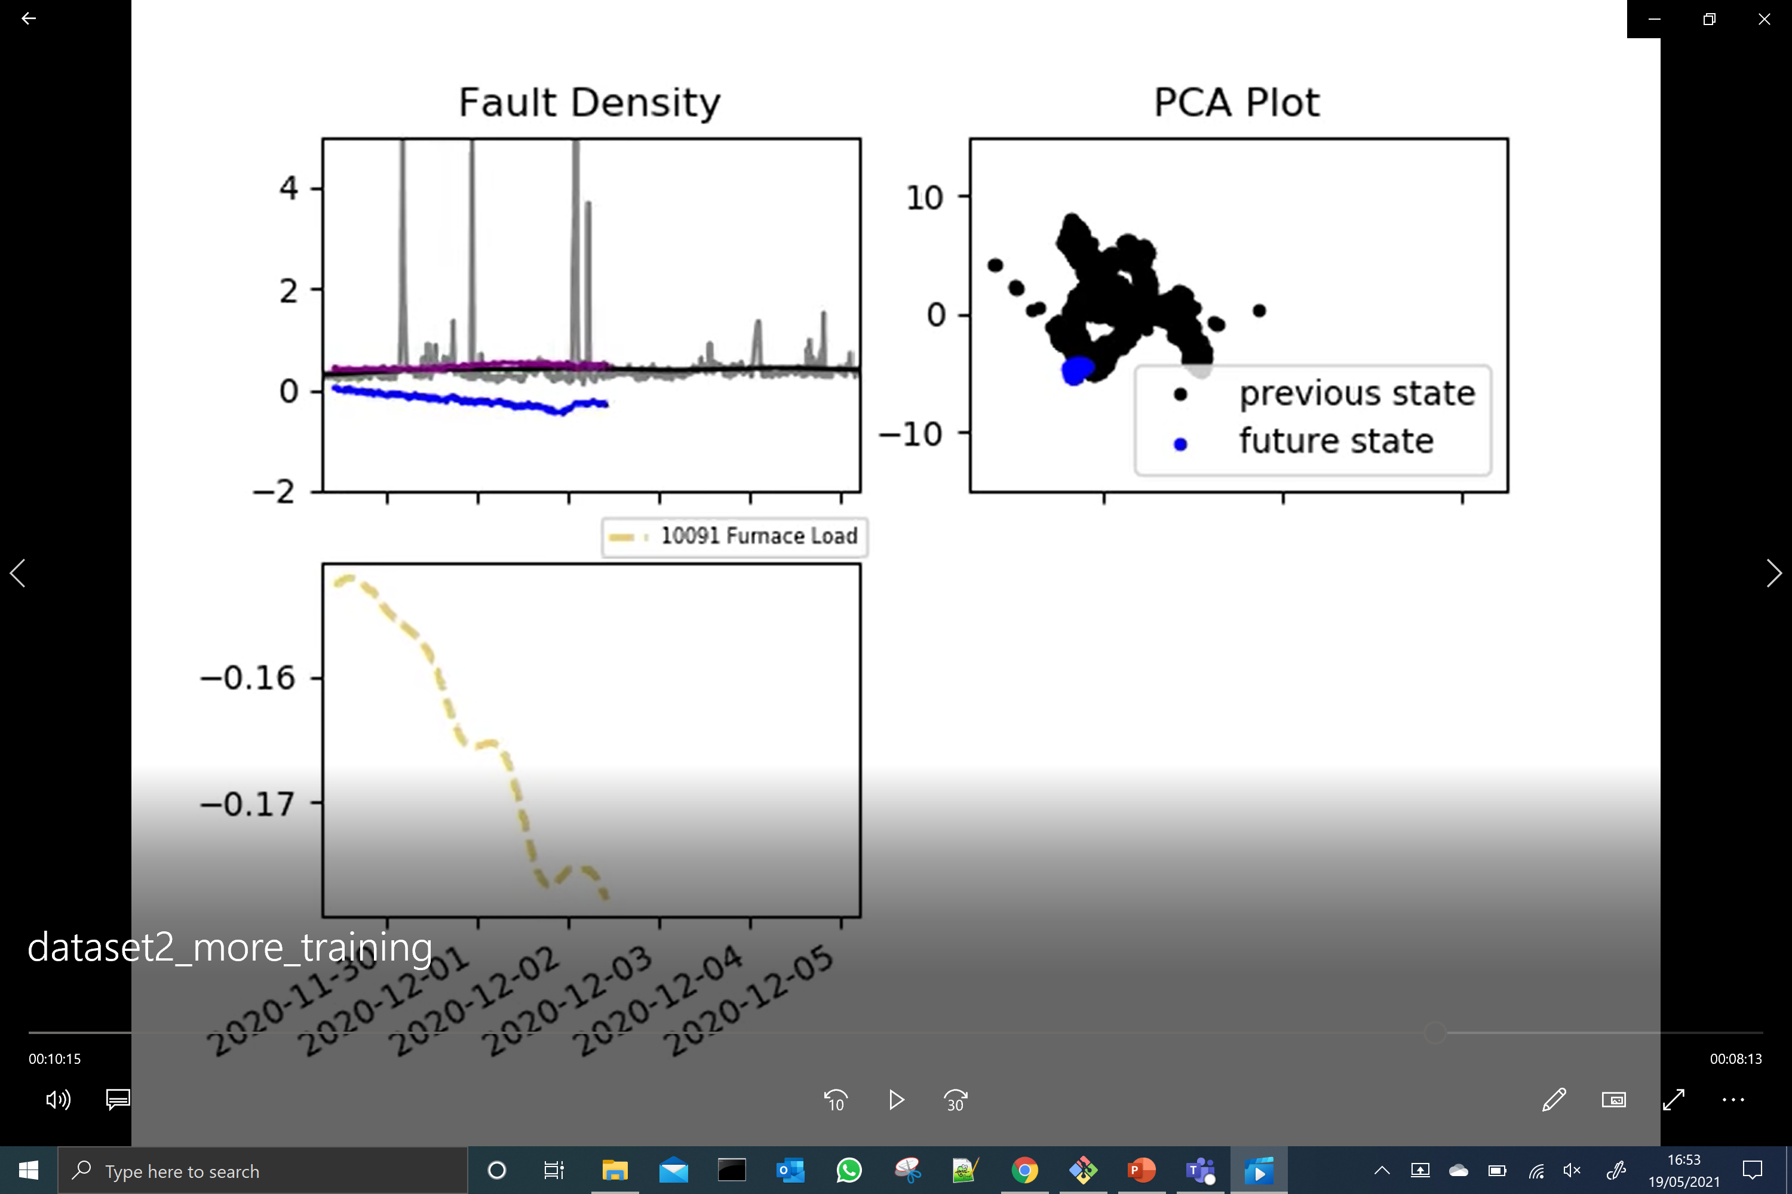
Neural Network – Dataset 2
Next we try using dataset 2 (with the improved combinations processing).
Now predicts the first rise.
Not perfect everywhere (though it isn’t clear to me whether or not we’d expect it to work here – note that it’s still batch trained)
But some very encouraging regions too.

Slide 12
Neural Network – Conclusions
Move to dataset 2, now using the neural network model? Is a significant change in direction but the results are very encouraging.
Interpretability?
There is a way of rating the ‘importance’ of each input; Automatic Relevance Determination (ARD).
We won’t have a model structure that we can ‘pull apart’ as easily, but do the users in the control room really need this?
ARD has been around a long time but we need to work out how difficult it will be to implement in this case (the Neural Network is implemented using an open-source library).
Online updating
Again, we are using an open-source implementation, but this doesn’t actually look too bad to implement.

Slide 13
Neural Network – Conclusions
We could also try a Gaussian Process on the same data
Here we should be able to do Automatic Relevance Determination relatively easily
Online updating might be more difficult (though we can still look at the mixture-of-experts approach).
More general point – it may be worth carefully selecting the training data so that it covers the majority of the PCA plot?

Slide 14
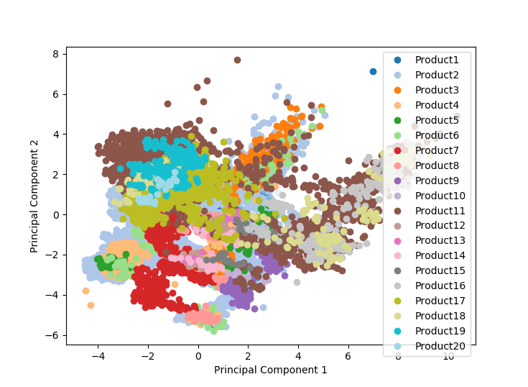
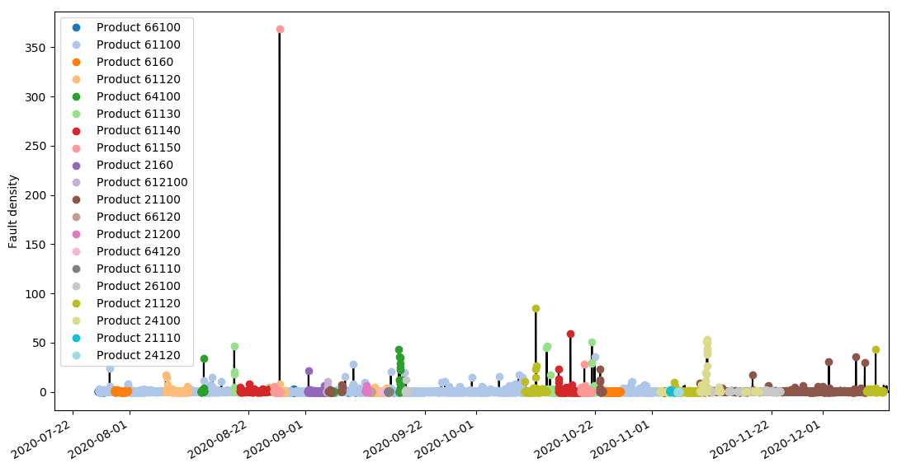
Clustering by product type
Product ‘TintID, CoatingID, ThicknessID, WidthID’
Showing only
20 product types
There are 24 product types

Slide 15
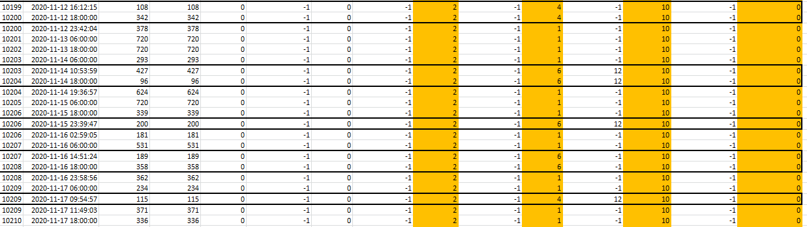
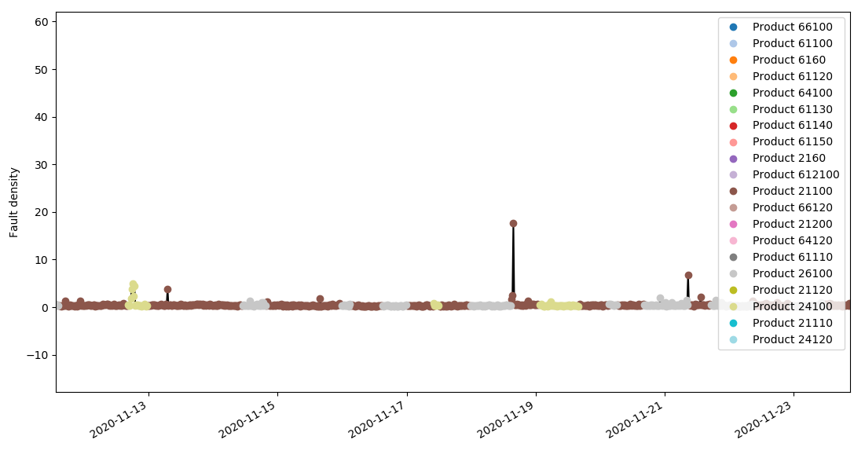
Clustering by product type
Only 8 Hrs.

Slide 16
Clustering by product type
Only 2 Hrs.

Slide 17
Density-based clustering
Density-based spatial clustering for applications with noise (DBSCAN):
Clusters are identified by density.
It is able to determine the number of clusters.
It is able to describe data points as being generated by noise.
Only 2 parameters have to be estimated.

Slide 18
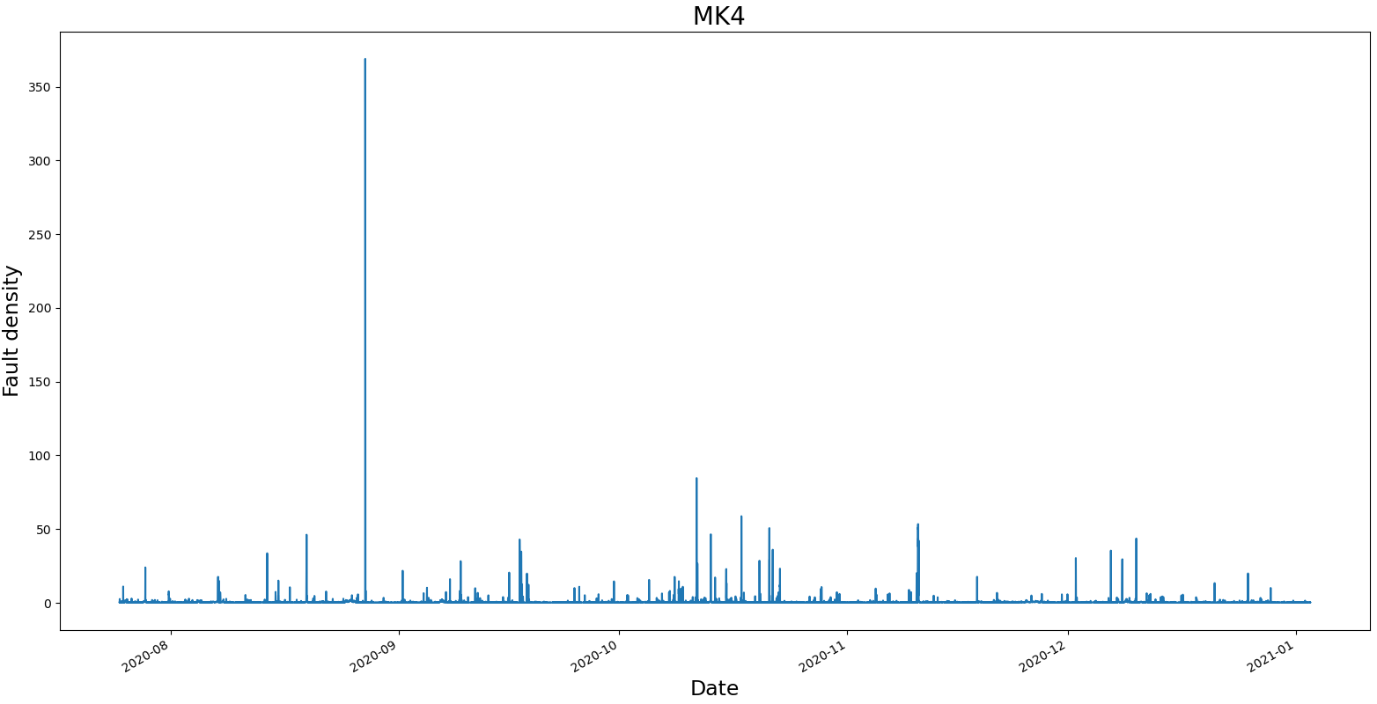
From August 2020 to January 2021
Noise

Slide 19
From August 2020 to January 2021
Noise

Slide 20
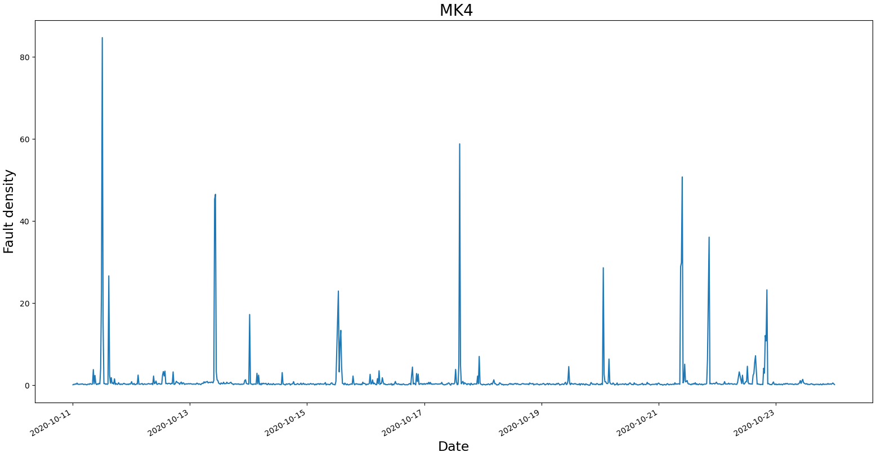
We choose a region with a high concentration of spikes
Noise

Slide 21
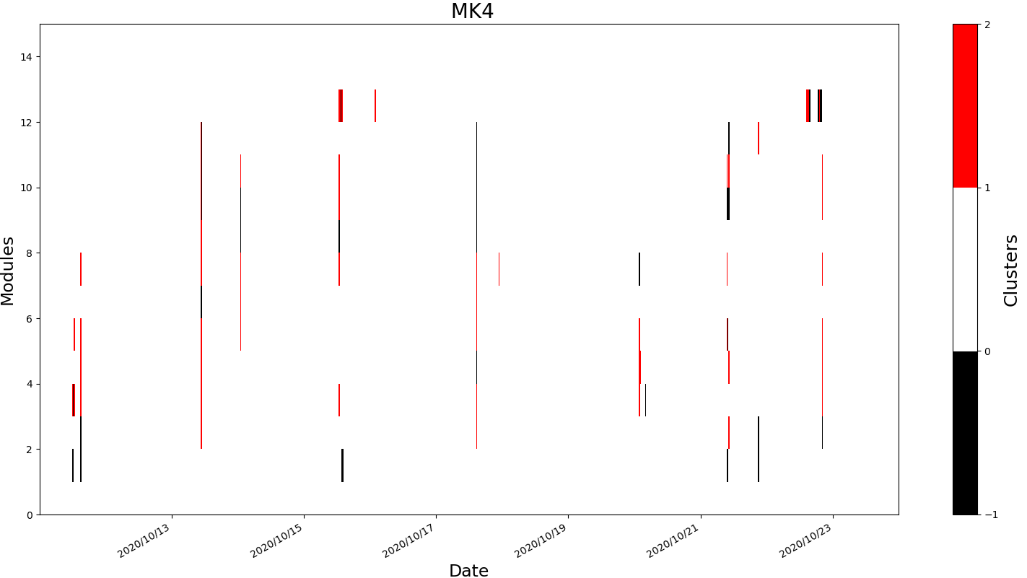
DBSCAN: 2020/10/11 to 2020/10/24
Noise

Slide 22
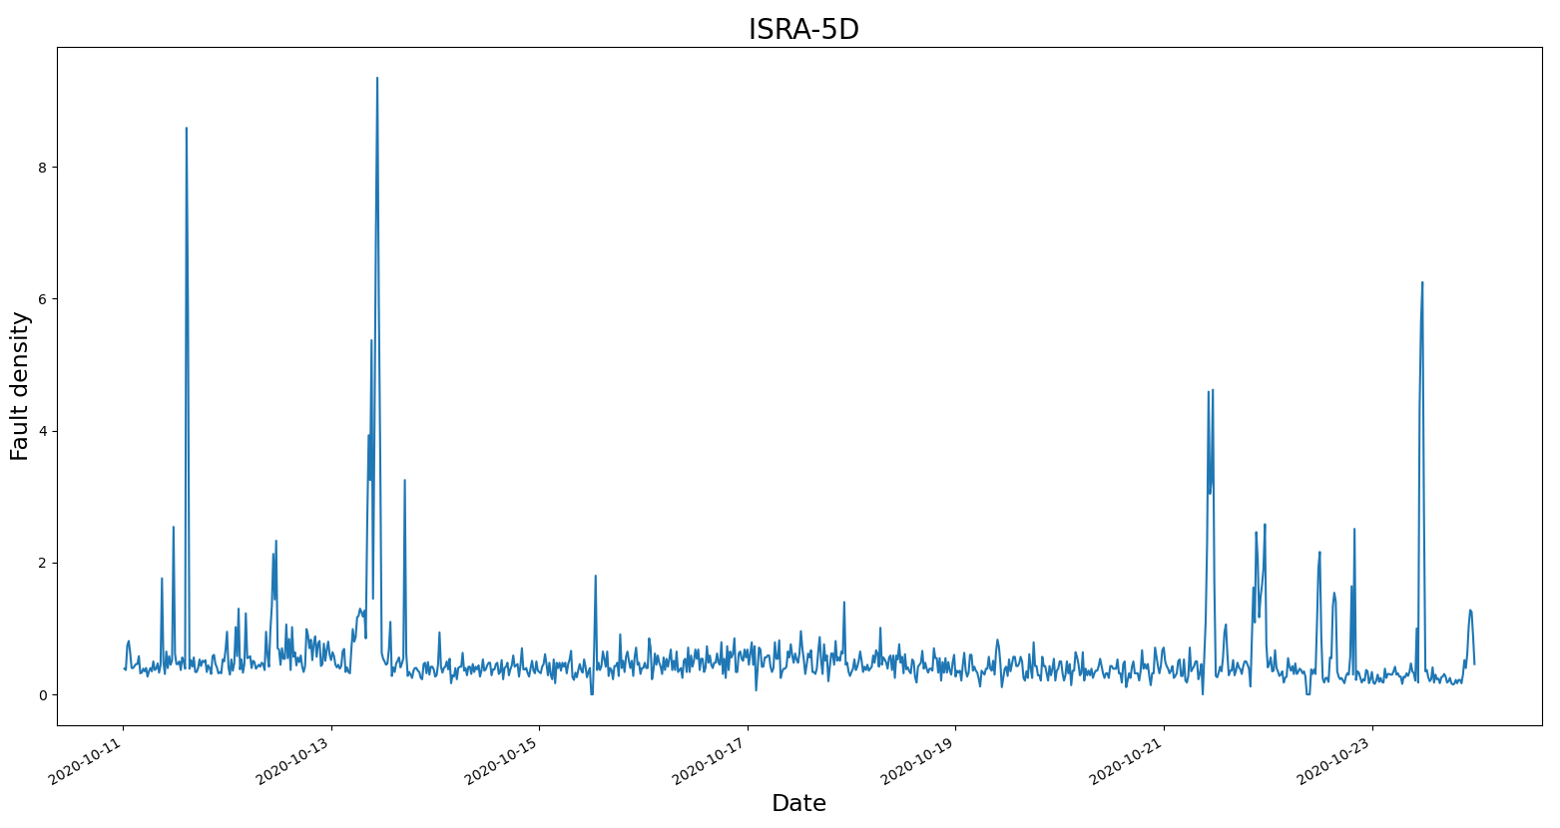
ISRA-5D at 2020/10/11 to 2020/10/24
Noise

Slide 23
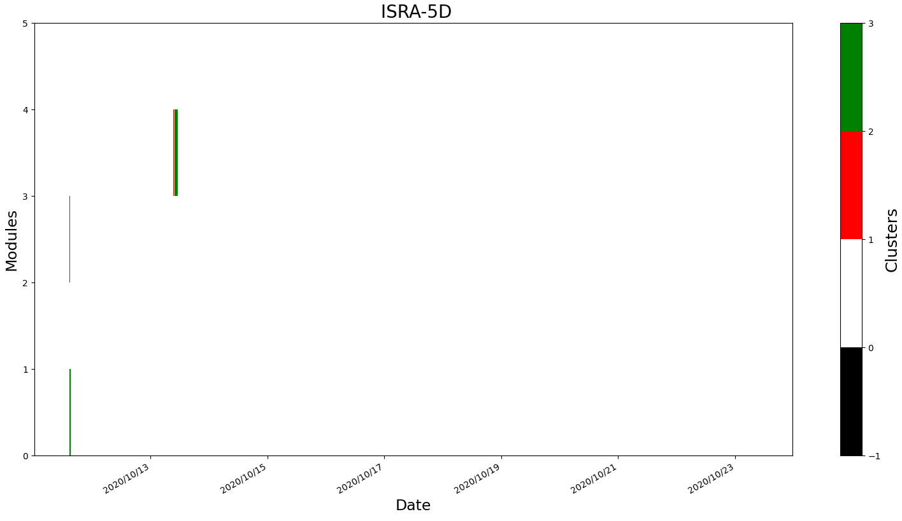
DBSCAN: 2020/10/11 to 2020/10/24
Noise

Slide 24
Upskilling
Things are moving quickly and we don’t always get to have a close look at the methods we’re deploying. So far we have…
Linear regression
How do we learn ‘online’?
What actually is a Neural Network?
How does PCA work?
Probably more…

Slide 25
Thank you for your attention. ANY QUESTIONS?

